Slide 1
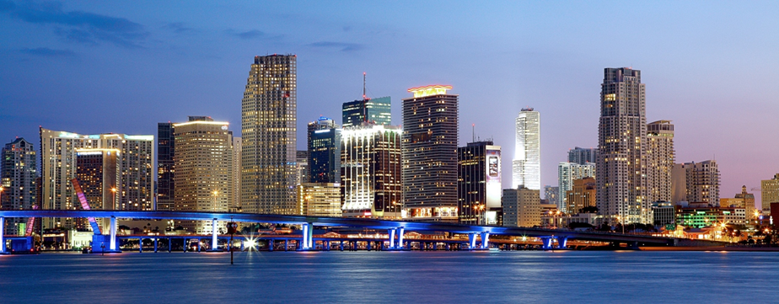
Demographics In relation to Fitness Centers in Miami neighborhoods
Team Members:
Alvaro Dal Bo,
Dunia Carmenates,
Edwin Johnson

Slide 2
Research Questions
Is there a relationship between the locations of fitness centers and income?
Determine if there are fitness center deserts for low income or percentage below the poverty line.
Determine if there are relationship between education level and frequency of gyms.
Is there a relationship for ethnicity?

Slide 3


Data Sets to be Used
Census API
Google Maps API

Slide 4

Data Wrangling and Visualization

Slide 5
Conclusion
We rejected null hypothesis for both Income per Capita and Percentage of Higher Education
Fitness canters are not heavily concentrated on specific demographics, but we found out a higher correlation of number of fitness centers to higher levels of education and the ethnicity of the neighborhoods
We expected a much higher relationship between Socioeconomic status such as Median Income, House Values, and Gym prevalence.

Slide 6

Questions?

